Slide 1
Sharing Science with Scientists & the Public
Brian McNoldy
Senior Research Associate 3
Lunch Bytes
7 September 2018

Slide 2
Rewind to mid-1990s
1994: coded my first text-only website, primitive graphical web browsers (e.g. NCSA Mosaic, Netscape Navigator) were just blinking into existence, text browsers (e.g. Lynx) were popular
1995: coded my first graphical website. Very basic features in browsers, but having images and mouse-clickable links revolutionized access to the ~100,000 websites around by 1996.
Quickly saw the utility in widely sharing fun science and math stuff like never before…

Slide 3
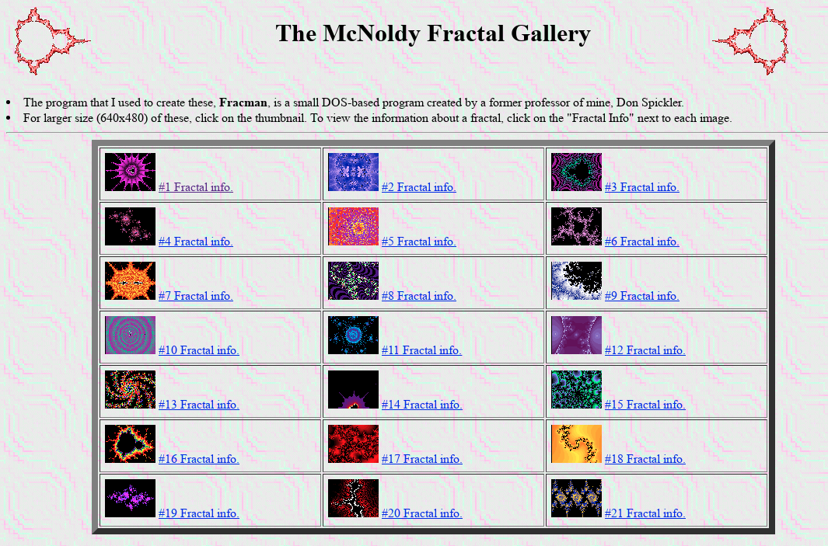
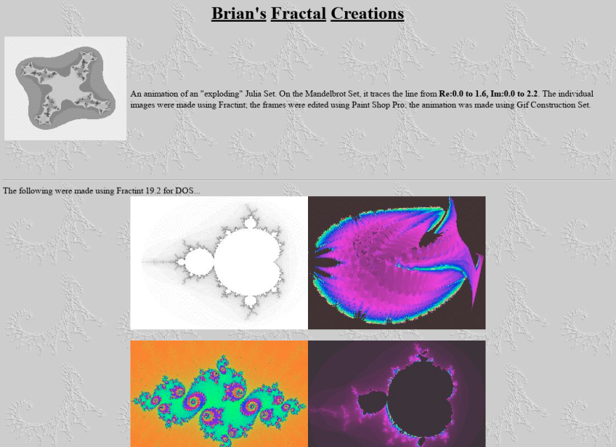
Fractals
Created galleries with images, equations, and software
Each one took hours to days to render on a 33 MHz desktop computer.
Color tables had to be manually created (some 4-bit, some 8-bit)
http://andrew.rsmas.miami.edu/bmcnoldy/gallery/fractals.html
http://andrew.rsmas.miami.edu/bmcnoldy/fractint/fractint.html

Slide 4
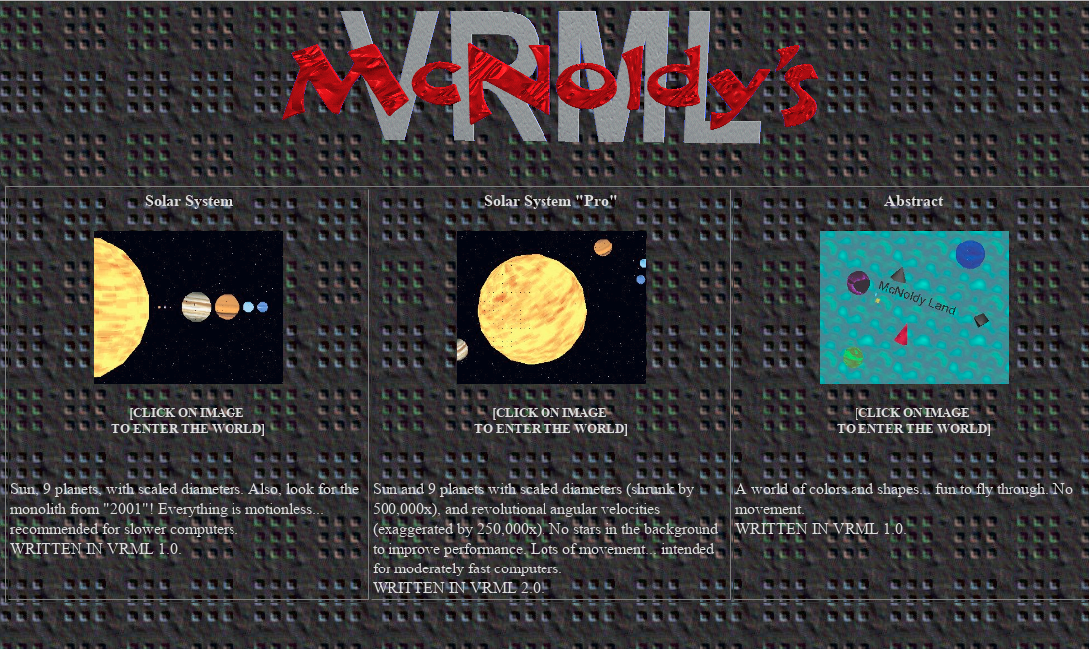
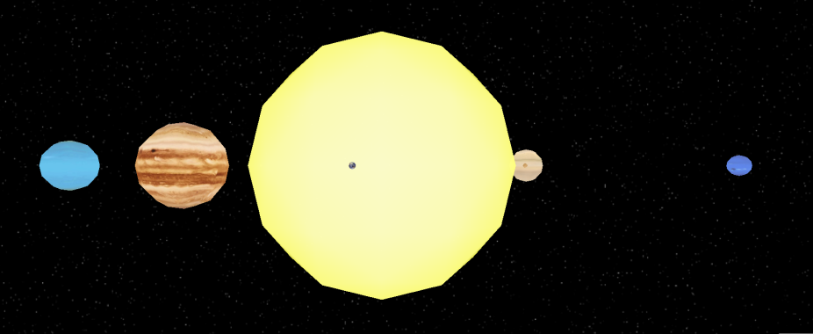
Astronomy
VRML, or Virtual Reality Modeling Language, was the ‘next big thing’ that would revolutionize the internet.
Released in 1995… I learned to code “worlds” right away. VRML v2.0 came out in 1996, browsers had default plugins.
My first application was a solar system with scaled planets, revolution rates, rotation rates
http://andrew.rsmas.miami.edu/bmcnoldy/vrml/vrml.html

Slide 5
Hurricanes
While a physics & astronomy major in college, I had been very interested in weather/hurricanes since childhood.
Started a “blog” in August 1996 to update interested friends on tropical cyclone activity in the Atlantic. Very casual, non-technical, one-stop-shopping for everything going on.
I did the work of compiling information from sources around the internet and provided a summary geared toward the public (only when there was activity; otherwise nothing).
Used a mailing list, which grew from ~5 subscribers at first to ~100 by end of 1996 season. Coastal residents, military, weather nerds, family, friends, business owners, etc.
Still doing it today, 22 years later (~1200 posts, ~350 TCs)

Slide 6
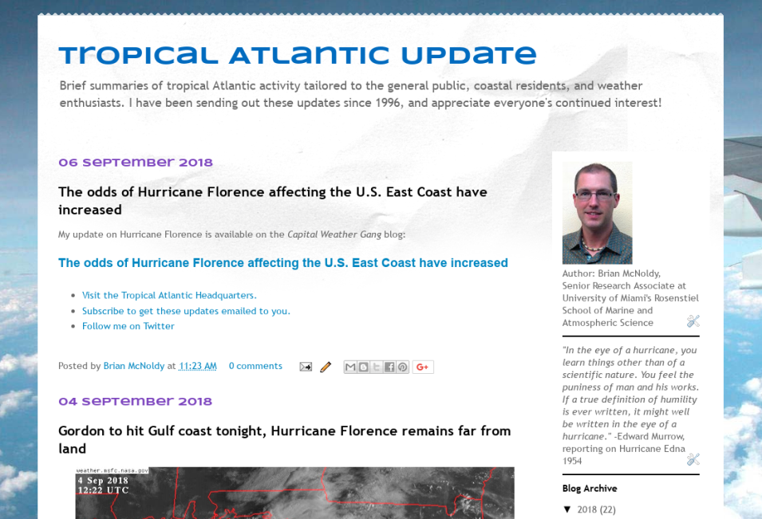
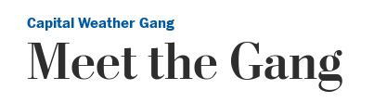
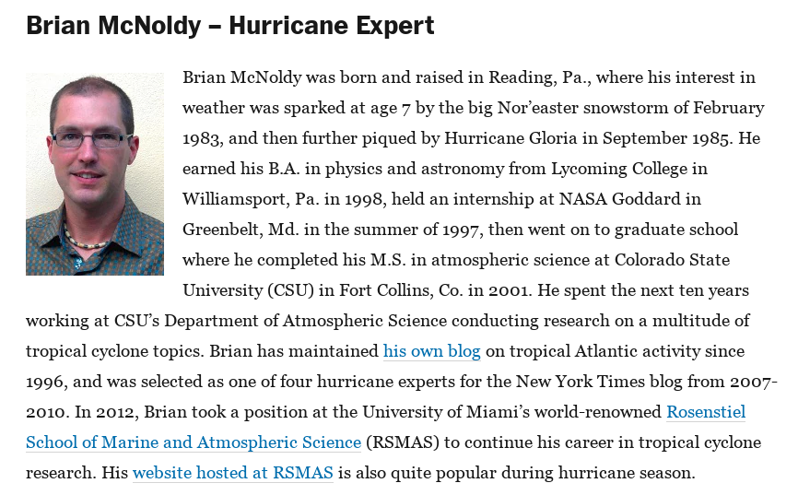
Hurricanes
Invited to blog about hurricanes for New York Times from 2007-2010
Invited to be the “tropical weather expert” for the Washington Post’s Capital Weather Gang from 2012-present.
Requires writing for the general public while relaying sometimes-challenging concepts
http://bmcnoldy.blogspot.com/
https://www.washingtonpost.com/news/capital-weather-gang/

Slide 7
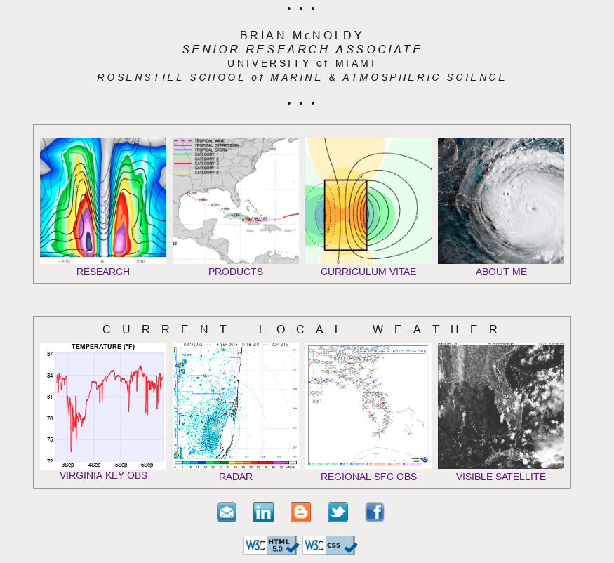
Website & Real-time products
Have hand-coded ~14 entire websites for myself, friends, organizations
Started generating and sharing my own real-time products on website ~2000
Pages coded in standards-compliant HTML, CSS, PHP, JavaScript
Used (and still use) BASH, IDL, and CRON for managing data, graphics, timing
Presently producing 1200-1500 images per day
Satellite, radar, models, climatology
http://andrew.rsmas.miami.edu/bmcnoldy/

Slide 8
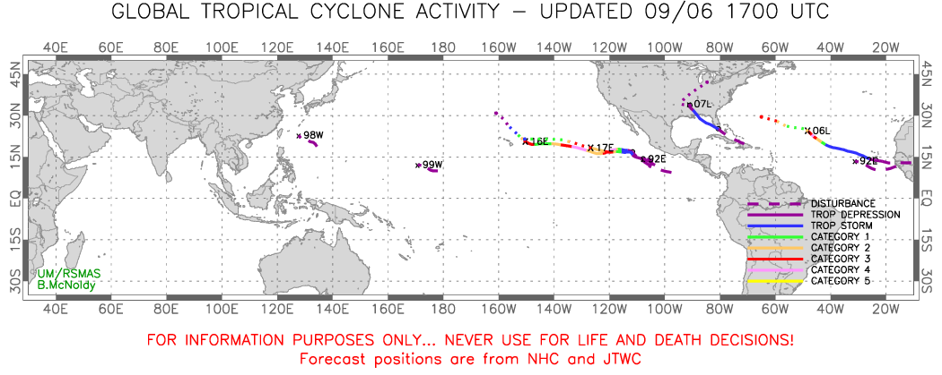
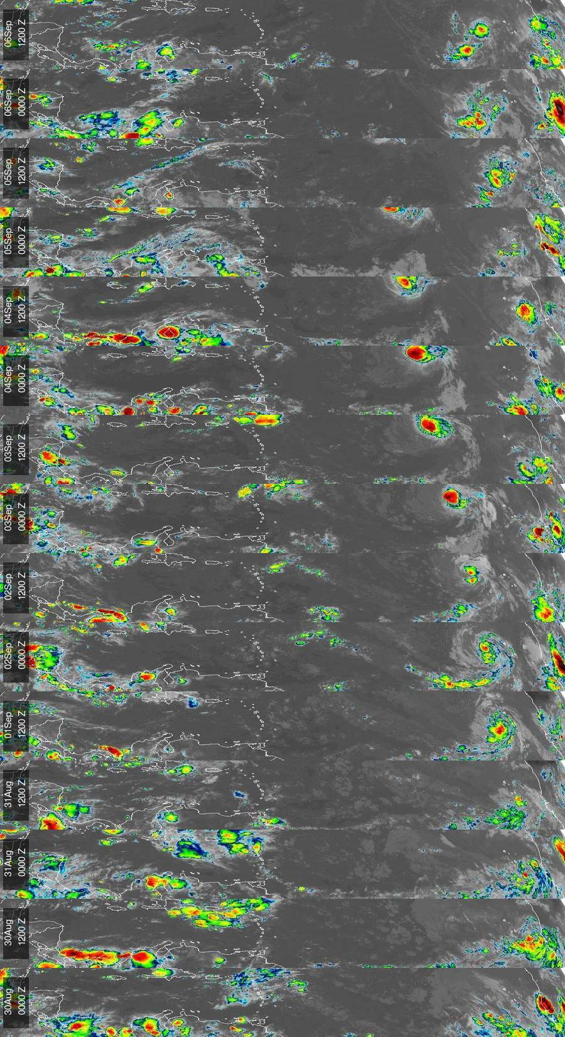
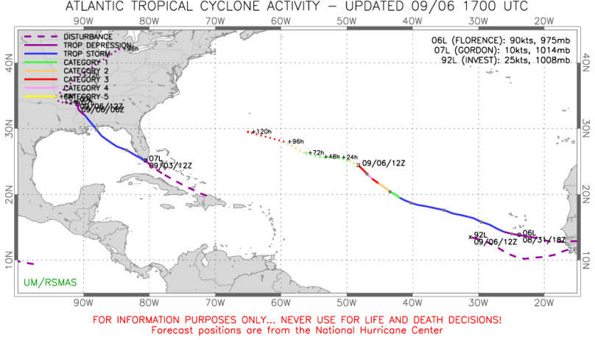
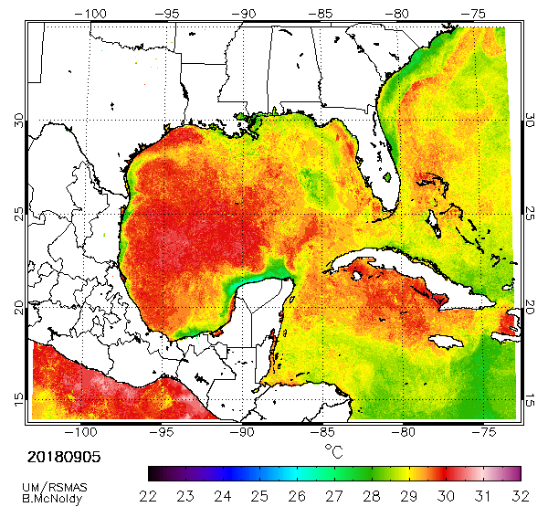
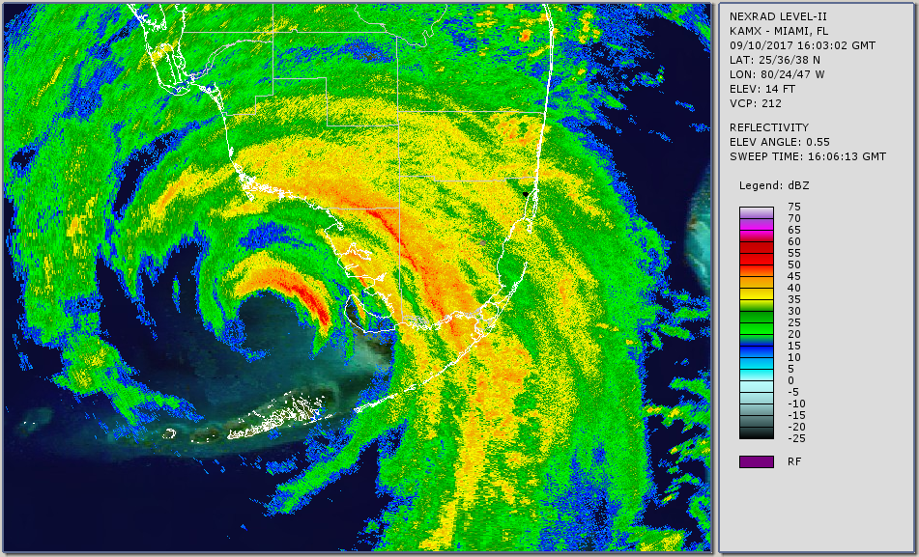
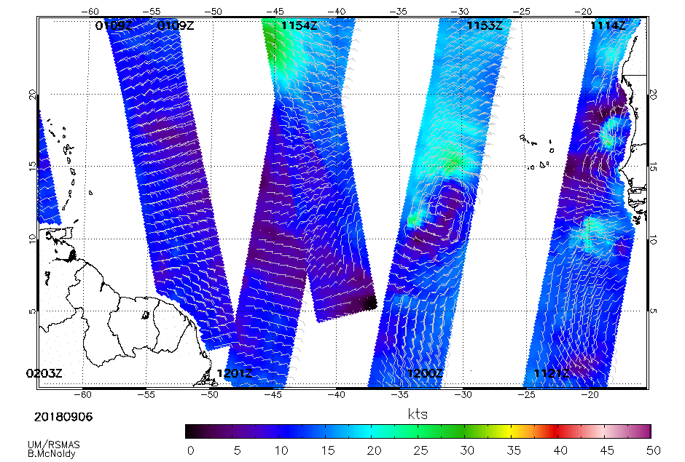

Slide 9
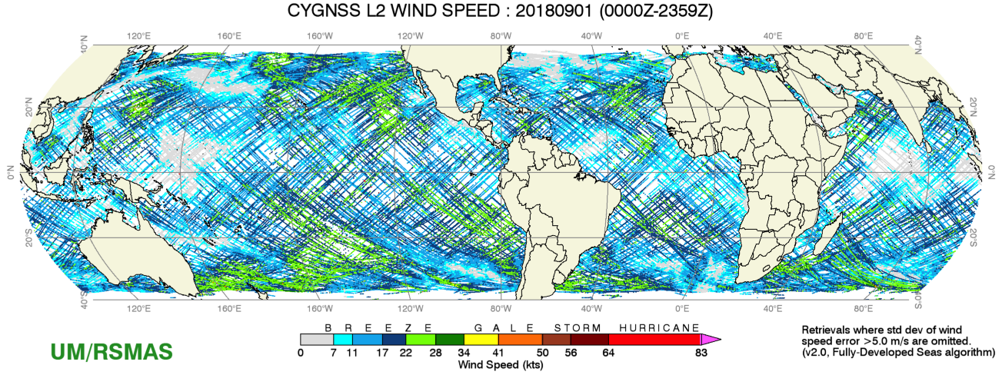
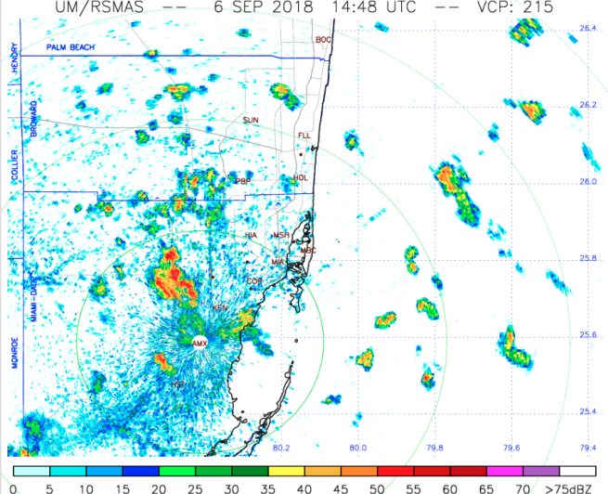
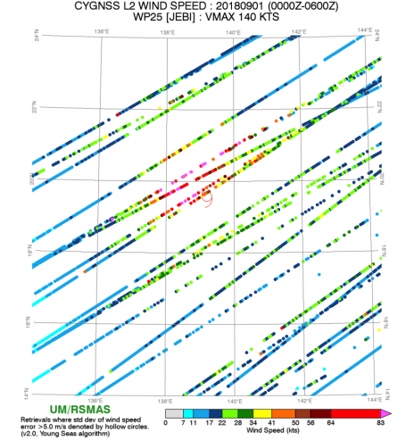
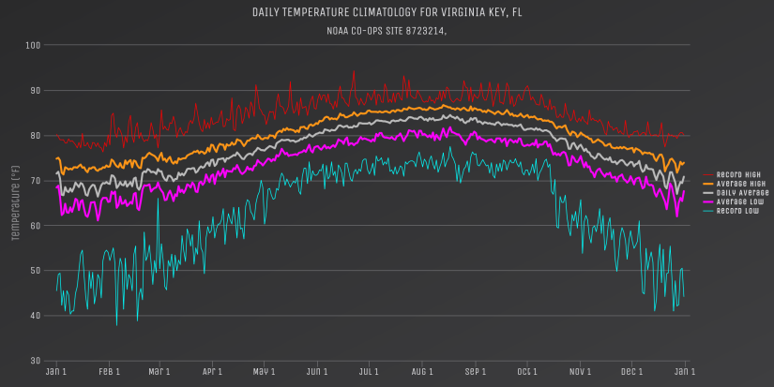
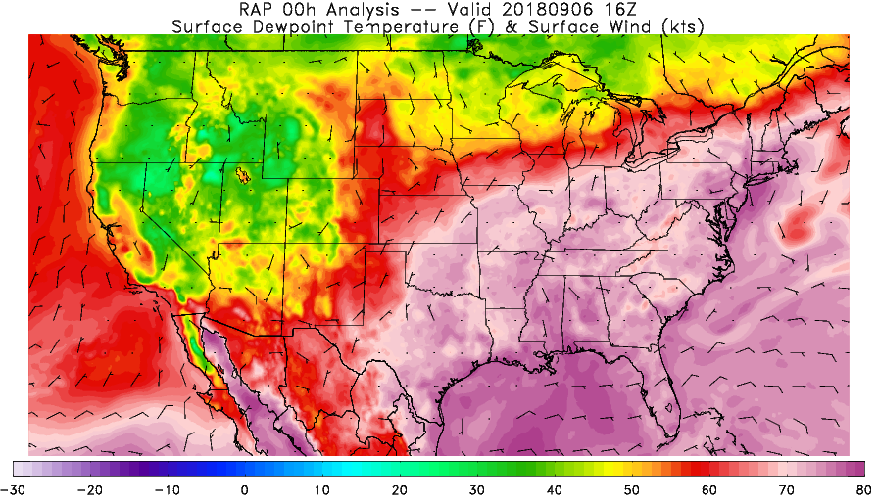
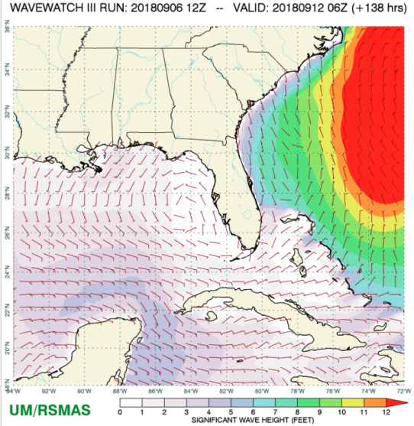
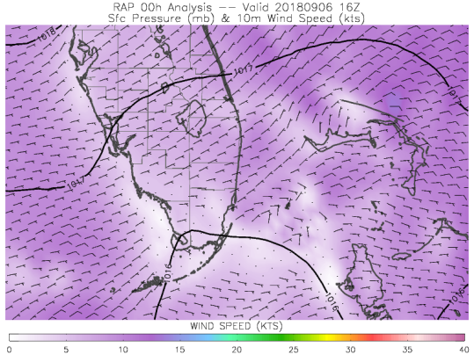

Slide 10
Tips for Sharing Science
Language needs to be non-technical! In rare cases, you might dip into an explanation of a concept/detail, but keep it brief and non-essential
Interested readers will enjoy it, others will skip it
Graphics need to be easy to interpret (colorful helps; most people are visual and there’s a lot out there to filter through)
Respond politely/professionally to responses/critiques
(it’s ok to ignore the tin-foil hat ones though!)
Scientists and the general public alike may not have a clue what you’re doing, but are willing and able to learn if given a chance
Keep it to digestible amounts… no books.
Sharing your work or something related to your work should be fun for you too; enthusiasm will show!

Slide 11
Website history
Lycoming College (1994-1998)
www.lycoming.edu/~mcnbria/
Colorado State University (1998-2001)
thor.cira.colostate.edu/~mcnoldy/
Colorado State University (2001-2011)
einstein.atmos.colostate.edu/~mcnoldy/
University of Miami (2012-2018)
andrew.rsmas.miami.edu/bmcnoldy/

